Slide 1

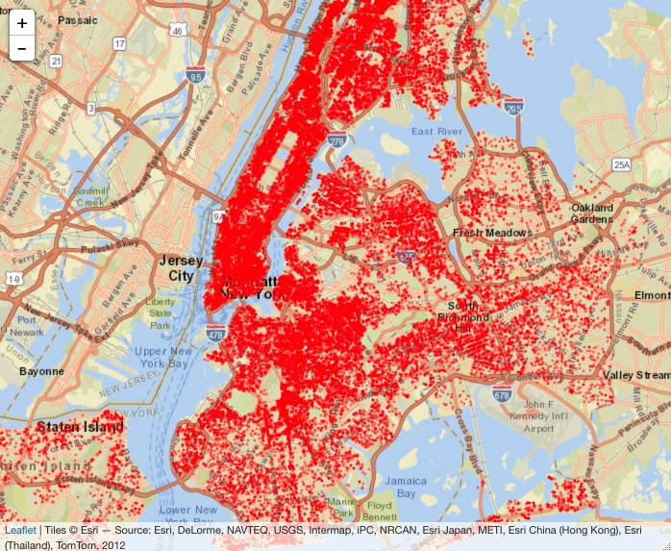
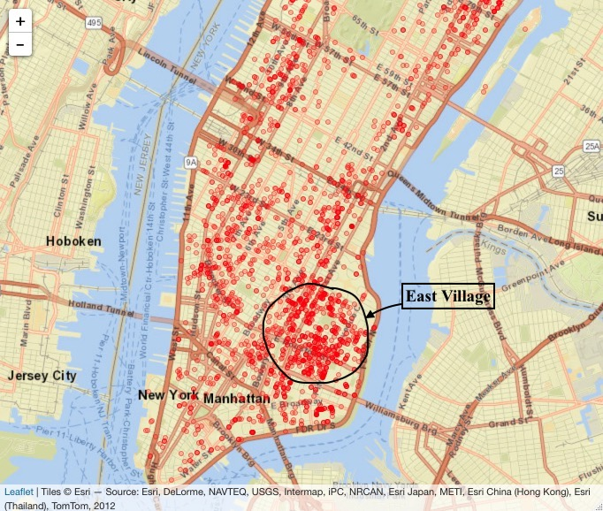
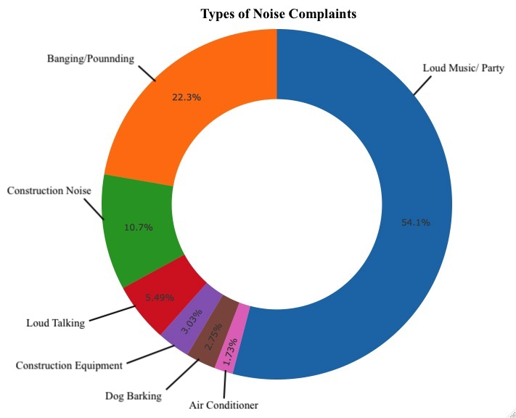
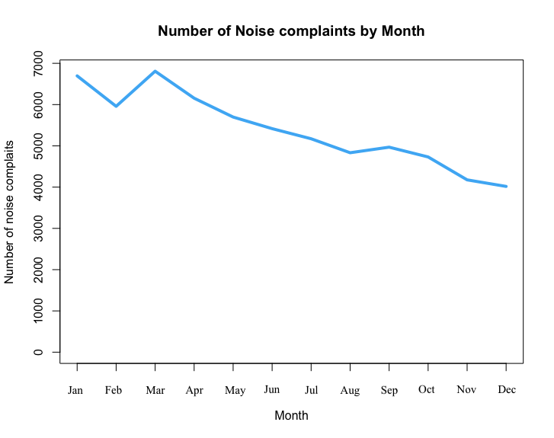
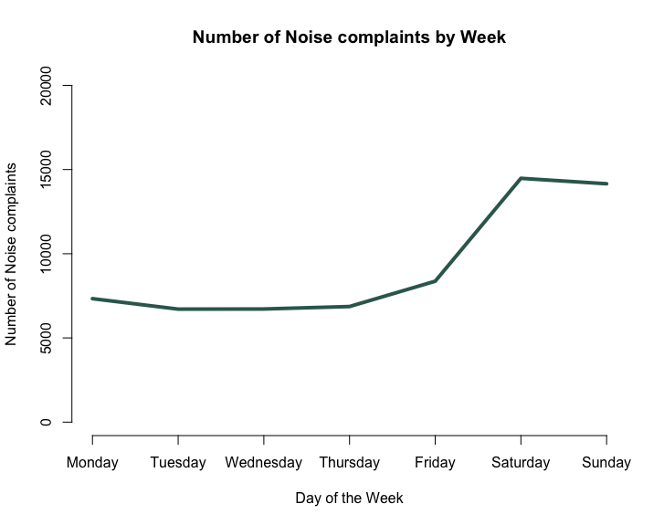
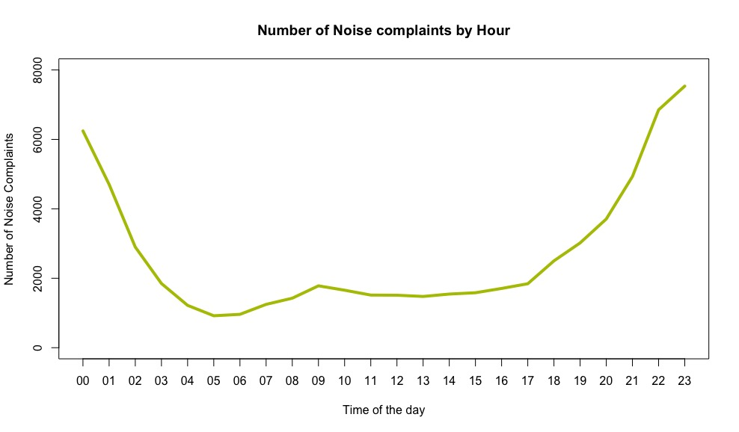
“The City that never sleeps” -
A visual analysis of New York City’s 311 Helpline
Tanay Pardeshi
IST 719
Information Visualization
Background Story:
Every day NYC311 receives thousands of requests consisting of non-emergency services, including noise complaints, sanitation problems, plumbing issues and illegally parked cars. These requests are received by NYC311 and forwarded to the relevant agencies such as the NYPD, Department of Sanitation or Department of Transportation, to name a few. The agency responds to the request, addresses it and the request is then closed.
I have identified major complaints affecting the residents of NYC and focused my analysis on noise complaints in the region of Manhattan.
About the Data:
I have used a comprehensive data set containing non-emergency 311 call details in the city of New York. I have filtered out complaints lodged by New York City residents from the year 2015 to 2018.
Audience:
My target audience is the residents of New York City and the various departments handling the complaints.
Data Questions:
What are the most common types of complaints?
What are the different type of noise complaints?
Time series analysis of complaints (Monthly, Weekly and Hourly)?
Spatial Analysis of Noise complaints?
What is the distribution of complaints by boroughs?
What are the busiest agencies handling requests?
Spatial Analysis of Noise Complaints on the Map of NYC:
Fig 4.0
The above figure denotes the number of noise complaints in the New York City region.
I have filtered the data to determine the noise complaints that were registered post midnight and till 6AM in the morning in the NYC region (with primary focus on Manhattan).
The map on the left shows the overall noise complaints in Manhattan, Staten Island, Bronx and Queens combined.
The map on the right focusses on complaints registered in Manhattan and clearly shows that East Village in Manhattan registers the most number of noise complaints.
East Village has the most number of pubs and bars therefore it becomes obvious that there will be a lot of complaints due to partying or loud music.
Most common types of Complaints:
Distribution of Complaints by Boroughs:
Fig 1.0
Residential Noise, Hot Water and blocked driveway were some of the major complaints identified.
Analyzing Noise Complaints:
Fig 5.0
Brooklyn and Queens have the largest area per square mile compared to other boroughs and they register the highest number of complaints.
Manhattan on the other hand is the smallest in terms of area yet there are approximately up to 1 Million complaints registered annually.
Major agencies handling complaints:
Fig 2.0
Majority of complaints were registered due to partying/ loud music, Banging/ Pounding or Construction
Time Series Analysis of noise complaints:
Fig 6.0
NYPD is the busiest agency and handles 150K complaints approximately.
HPD and DOT are also some of the major agencies that are kept busy throughout the year
Inference:
References:
Residential noise is the most common type of complaint lodged.
Partying/ Loud music is the predominant noise pollution factor.
The most number of noise complaints are registered during midnight on weekends and in the months of January and February.
East Village in Manhattan is the noisiest region in NYC.
NYPD, HPD and DOT are some of the busiest agencies handling 311 requests.
Dataset Link: https://data.cityofnewyork.us/Social-Services/311-Service-Requests-from-2010-to-Present/erm2-nwe9
Packages used: Rsocrata, ggplot2, leaflet, Plotly, sqldf.
https://www.wired.com/2010/11/ff_311_new_york/
https://en.wikipedia.org/wiki/3-1-1
Fig 3.0

